Slide 1
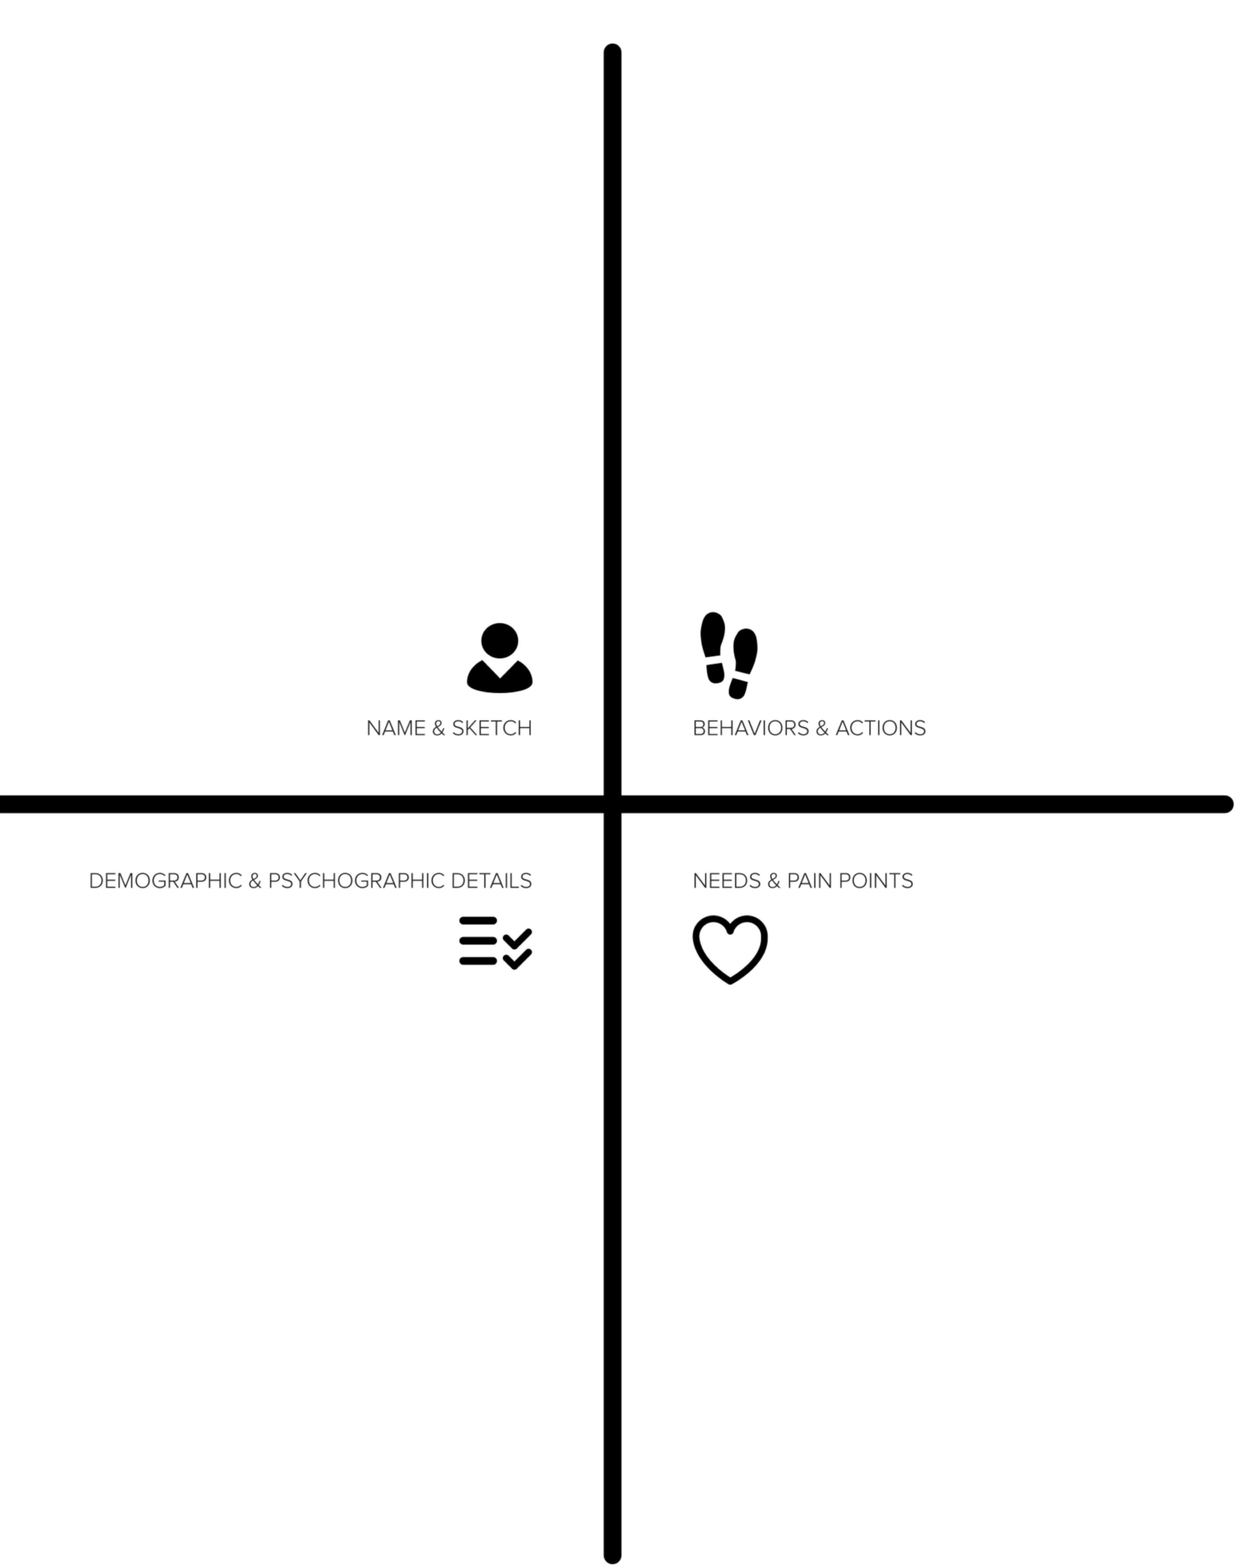

Slide 2

Gets panicked and work extra to deliver projects on-time within Budget
Go extra mile to get more projects for the team.
Always in look out for volunteers within team to work on items which are beyond their roles.
Available to do things which are outside his role and sometimes work as a backup for other roles.
Confident that he has the control of the group and he is the managing authority.
Enthusiastic in learning business. Randomly talks with business people and Architects to get to know more about businesses and current solutions respectively.
Shahid Nadeem
He works from Richfield, MN office.
He is from Wealth Management TOS group.
He is Development Group Manager and he manages the BPM technology Projects mostly for Wealth Management and Investment Services groups.
He takes a lot of responsibility to deliver the project on time and within budget. Sometimes gets panicked, however is keen to know more about business and validate his understandings.
Also he talks with his business lines contacts and technical contacts to get more information about business and solutions existing today. However these conversations are random.
Sometimes response from business lines takes time or business is not clear about certain requirements or they change the requirements. If he has enough information about business himself and if business collaterals are available to him then this can work as backup for him and he can give feedback to business lines accordingly which they can validate and will also help business lines in arriving on conclusions.
He does not know if there is one place where information about about existing solutions and technologies is available. This information is passed on from mouth to mouth and gained through experience, but faste approached is always welcome.
He wants to get more projects for BPM technology but is handicapped to perform this activity effectively as one consolidated repository of information for business/exisiting technical solutions & technologies/business challenges being faced/bottlenecks and loopholes in business processes etc. is not available to him.

Slide 3
How might we
[solve]
[this thing]
for
[this person]?

Slide 4
How might we
[facilitate]
[Submission of issues to ask for solutions]
for
[business lines]?

Slide 6

Chatting Platform
Center of Excellence
Yammer

Slide 7
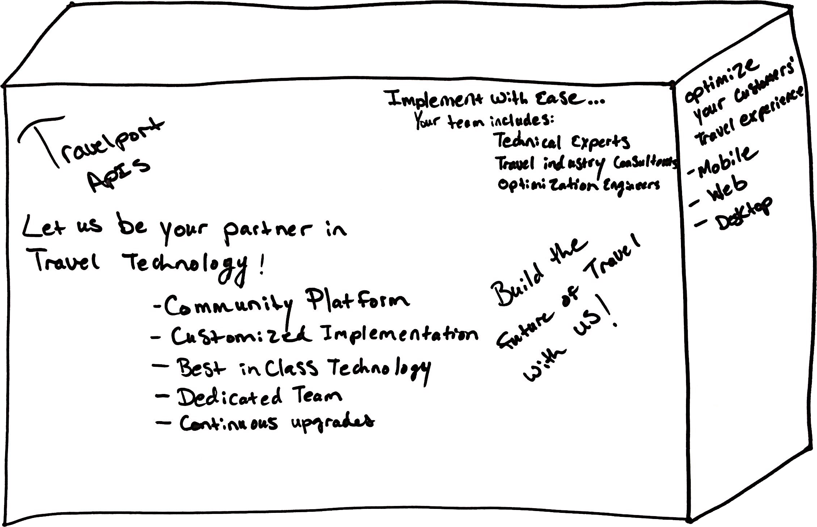

Notes:
Think of the exciting and colorful product boxes you see every day in super markets, shops, and portrayed virtually through online stores. The messages on these boxes help move these products off the shelves and into customers’ homes and lives.

Slide 8
Schedule a design coaching call with Econic here:
https://calendly.com/jonkohrs
Notes:
Think of the exciting and colorful product boxes you see every day in super markets, shops, and portrayed virtually through online stores. The messages on these boxes help move these products off the shelves and into customers’ homes and lives.

